Slide 1

CO326 PROJECT
PRESENTATION
Group Members:
E/17/012 Amarasinghe R. A. A. U.
E/17/038 Chandrasekara C.M.A
E/17/040 Chandrasena M.M.D
E/17/044 Coralage D.T.S.
E/17/101 Gunathilaka S.P.A.U.
E/17/242 Perera C.R.M.
E/17/252 Perera U.A.K.K.
E/17/356 Upekha H.P.S
E/17/407 WIjesooriya H.D

Slide 2
Introduction
OBJECTIVES:
Appropriate use of electricity and reduce overall demand.
Optimizes the cost and economic efficiency in the associated smart building
Maximizes the penetration of renewable energy
.

Slide 3

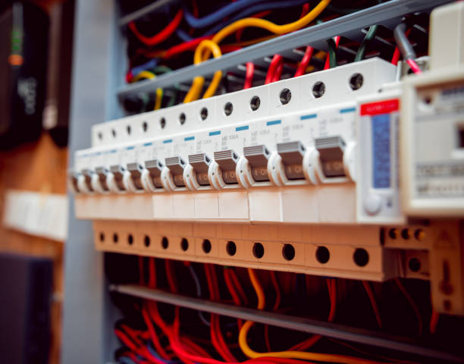
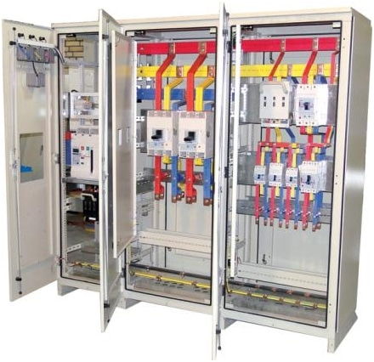
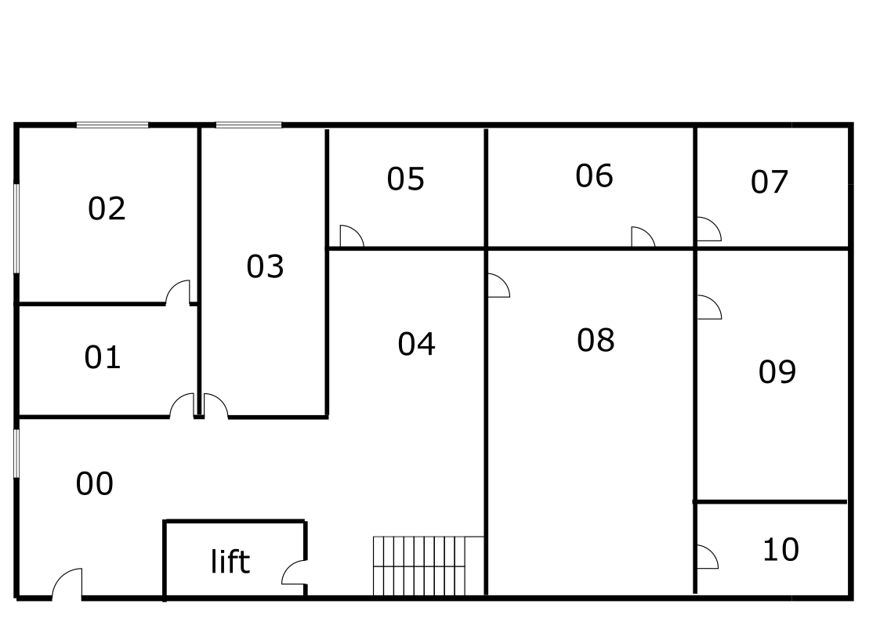
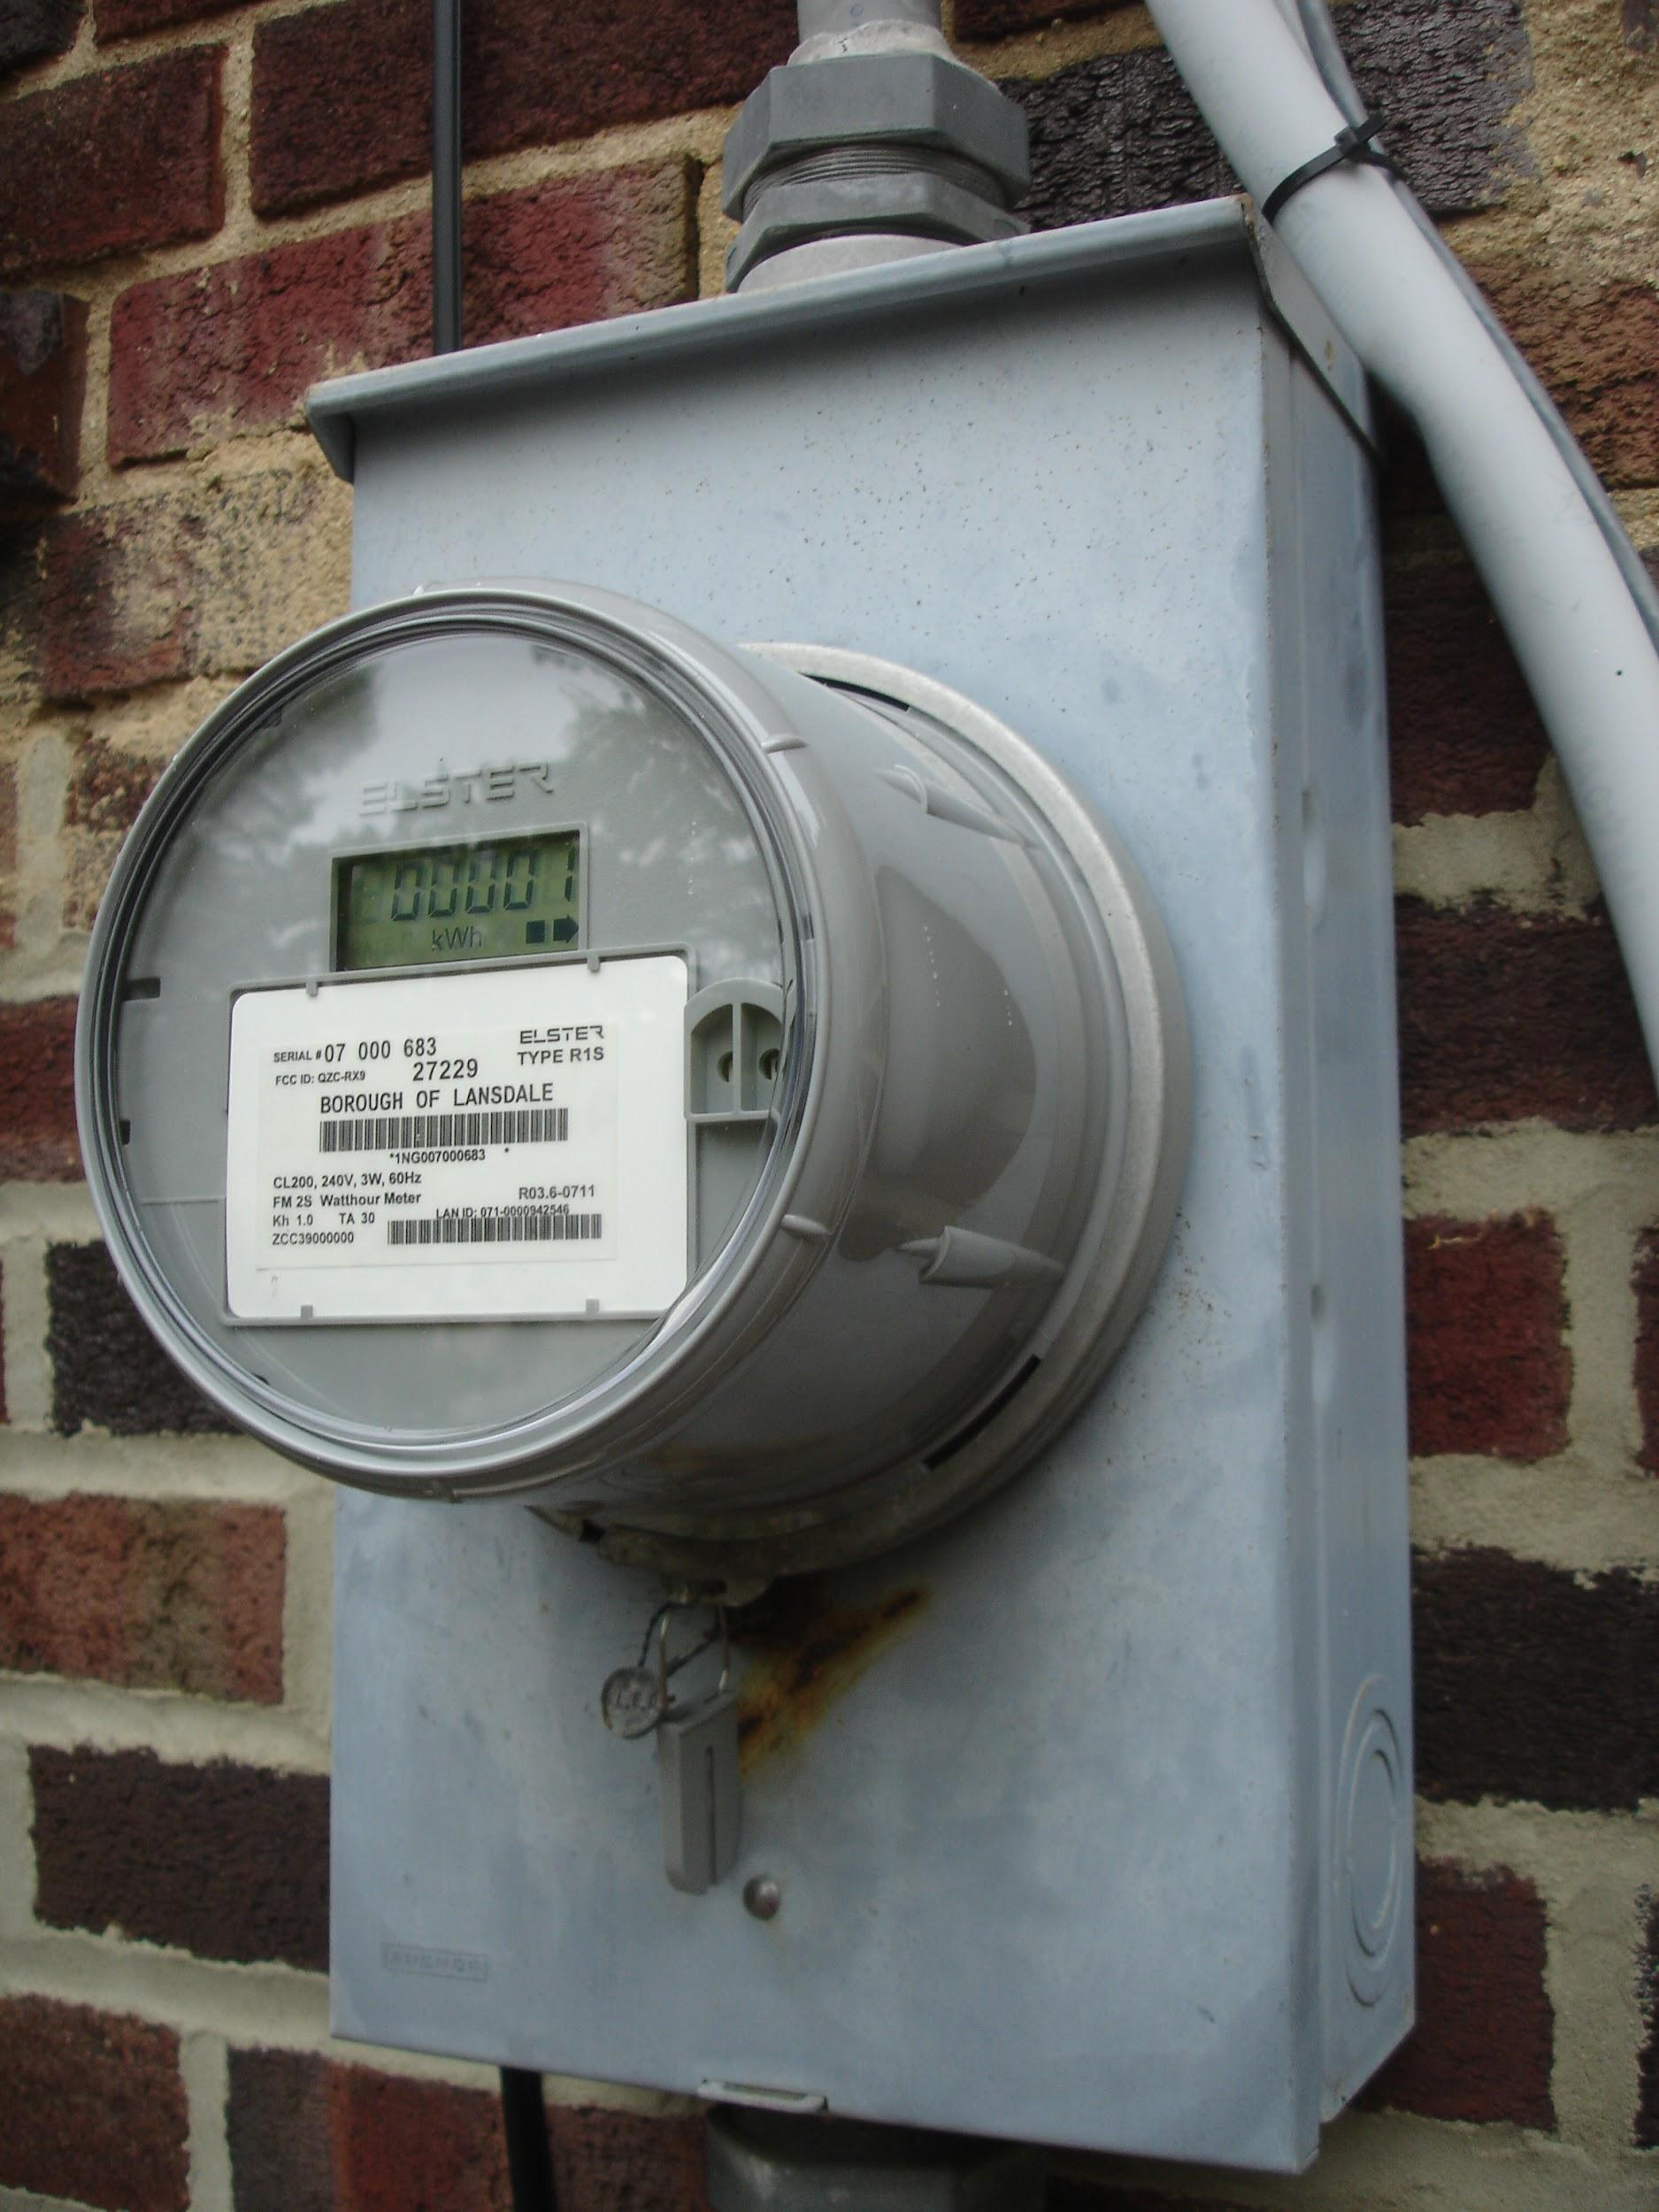
System Overview
Main switch gear
For the building
Sub distribution panels
For each floor
Essentials and Non- Essentials
AHU
Boilers
Chillers
Lights
Sub meters
For each units in the rooms

Slide 4
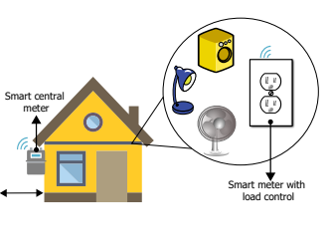
Main unit of the system
Smart Energy Meter with load control
Replace the traditional electrical outlet
Measures energy consumption and allows the on/off switching of devices connected to it
The meter unit is built around the ADE7758 as an energy measurement unit, the ESP8266 microcontroller, the CST-1020 current transformer, a resistive attenuator for the voltage input and an integrated power supply HLK-PM01

Slide 5
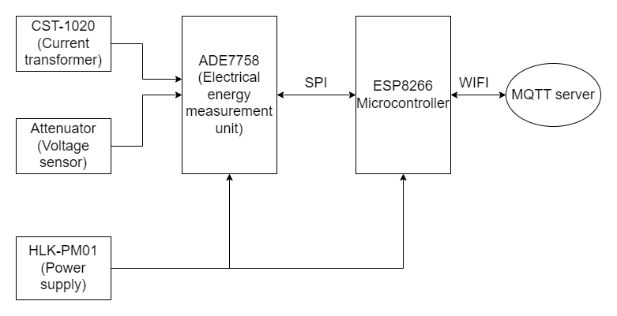
Architecture of the smart meter

Slide 6
Sub topic | Data format
Monitoring power consumption readings
floorX/power | { “floorno” “unit” “power”: power consumption “timestamp”: time of sensor reading }
floorX/roomX/power | { “floorno” “roomno” “power”: power consumption “timestamp”: time of sensor reading }
floorX/roomX/<unit>/power Unit: ahu, b, c ,lighting/essential, lighting/nonessential | { “floorno” “roomno” “unit” “line”: for lighting essential/nonessential “power”: power consumption “timestamp”: time of sensor reading }

Slide 7
MQTT and actuators
Decisions made at SCADA should be sent to the actuators. The decisions can be with respect to the immediate sensing values or long term processed data.
In traditional energy distribution system the main actuator is circuit breaker.
But in this smart building system the circuit breakers are replaced with Relays.
Actuators:-
Load Switches (SRA-05-VDC-CL.) -
To control load at switchgear and distributional panels.
Can handle loads upto 20A and good combination of size and performance.
Generator starter actuators -
For an automated start of the generator

Slide 8
Architecture of Load Control
Relay
(SRA-05-VDC-CL)
AC Plug
ESP 8266 Microcontroller
MQTT Server
WIFI
Relay
(SRA-05-VDC-CL)
AC Plug

Slide 9
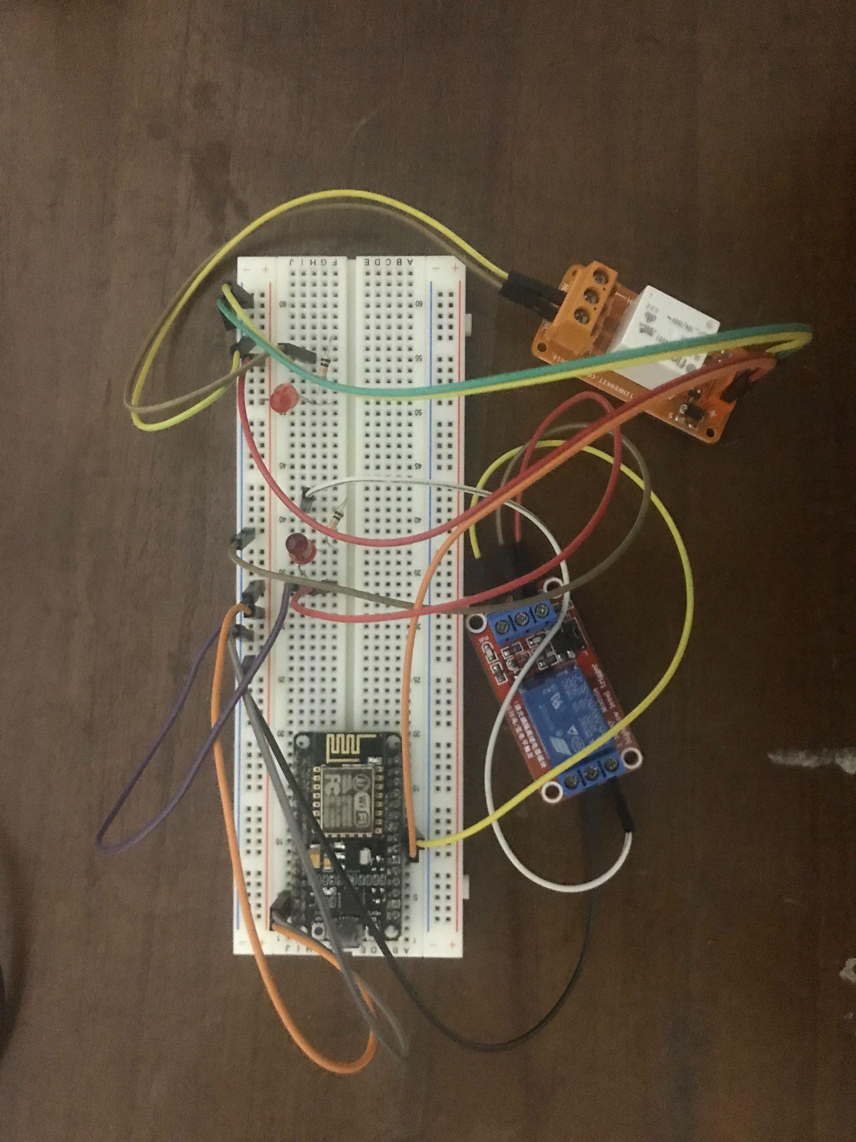
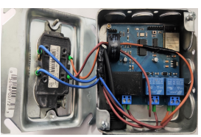
Circuit for Load Control
Actual Circuit
Demo Circuit

Slide 10
Control of Actuators with MQTT
Basically the control is done in two ways and the control decision is sent as mqtt payload.
Two methods:
Manually by SCADA switches - Priority is given to the switches which can be controlled directly and manually at SCADA system.
Automatically by written programs to control according analyzed previous data.

Slide 11
Sub topic | Data format
Control signal for acutators
floorX/power/control | { “State”: 0/1, “Line”: “e”/”n”, “Mode”: “m”/”a” }
floorX/roomX/power/control | { “State”: 0/1, “Line”: “e”/”n”, “Mode”: “m”/”a” }
floorX/roomX/<unit>/power/control Unit: ahu, b, c ,lighting/essential, lighting/nonessential | { “State”: 0/1, “Line”: “e”/”n”, “Mode”: “m”/”a” }

Slide 12

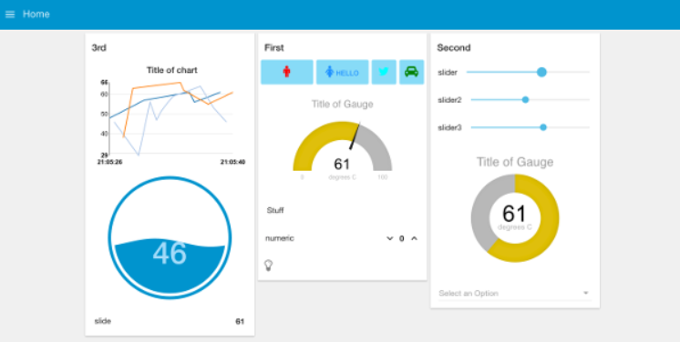
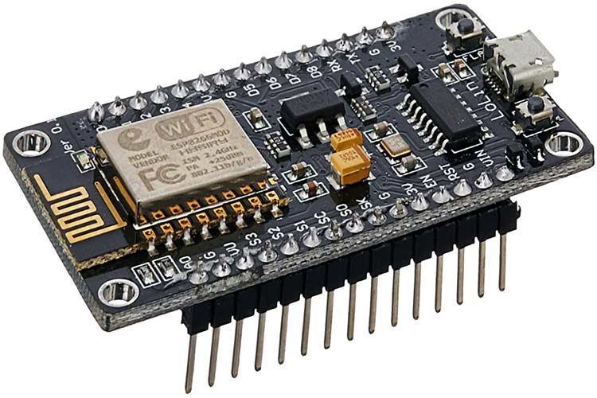

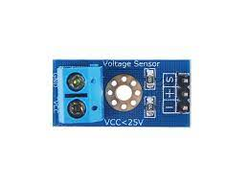
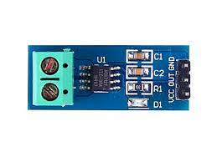
Read data from the MQTT Server , display the status of the system on SCADA
MQTT broker
Publish
Subscribe
Publish
Microcontrollers and Sensors
SCADA system

Slide 13
Information that will be published to the SCADA system
Power consumption of units:
AHU
Boilers
Chillers
Lights
Total Power consumption in rooms.

Slide 14
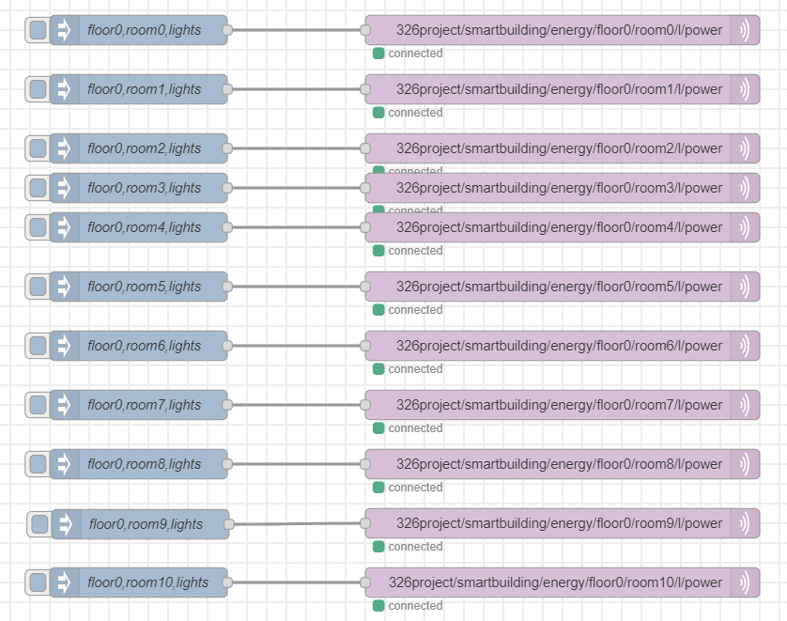
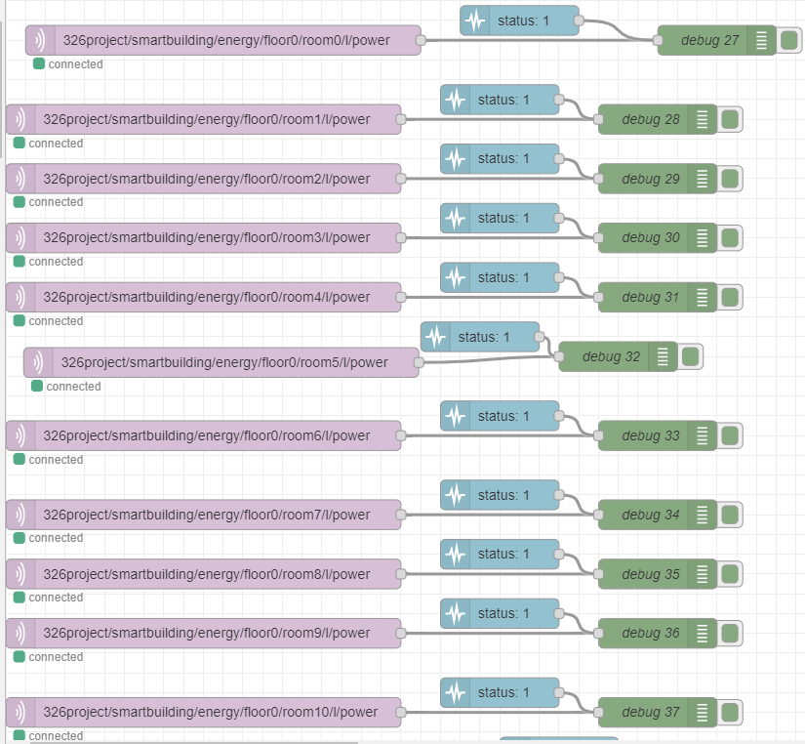
Implementations in Node-RED

Slide 15
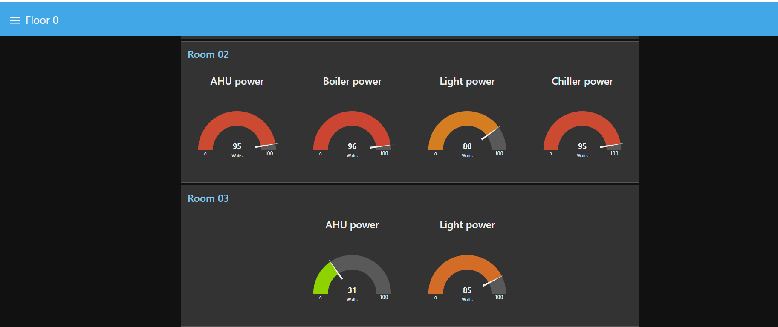
Power Consumption of Units - Node-RED Dashboard

Slide 16
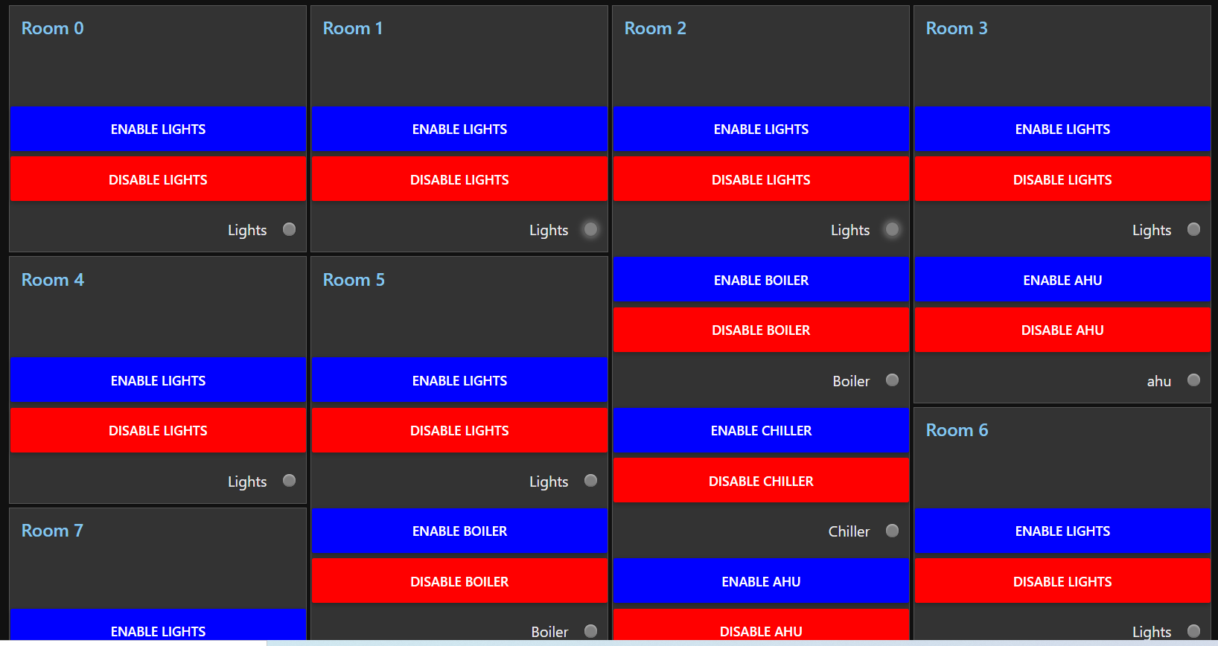
Inputs from SCADA and MQTT

Slide 17
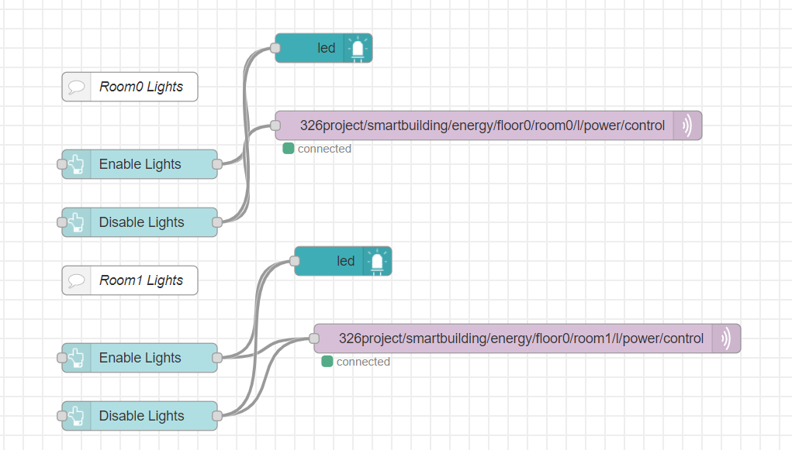
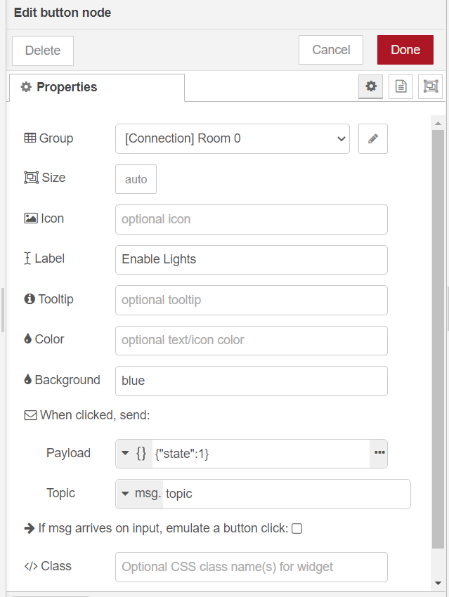
Node-Red implementations & Payload sent from SCADA

Slide 18
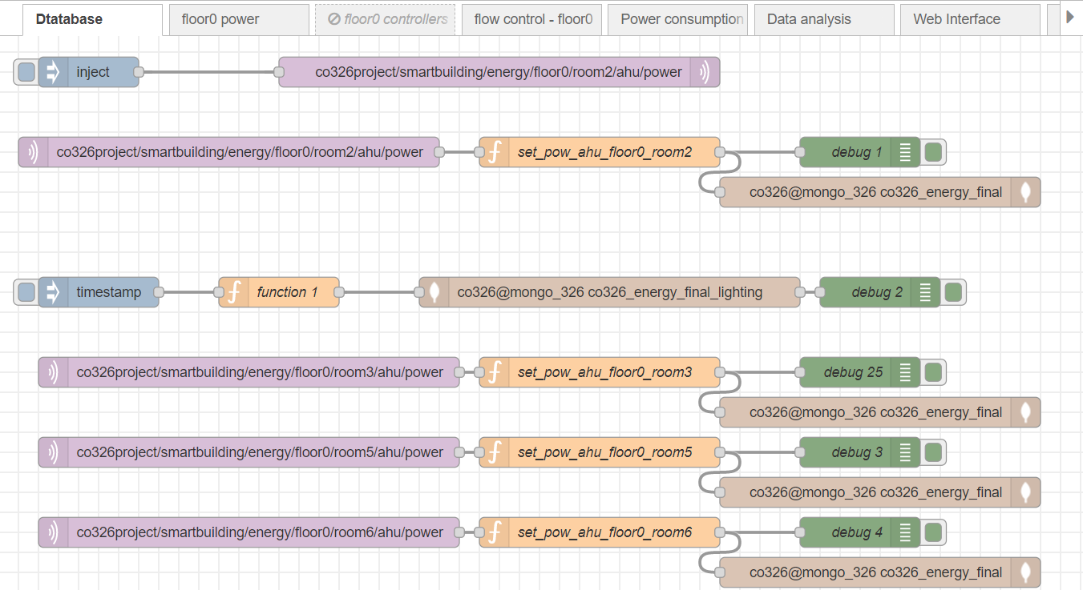
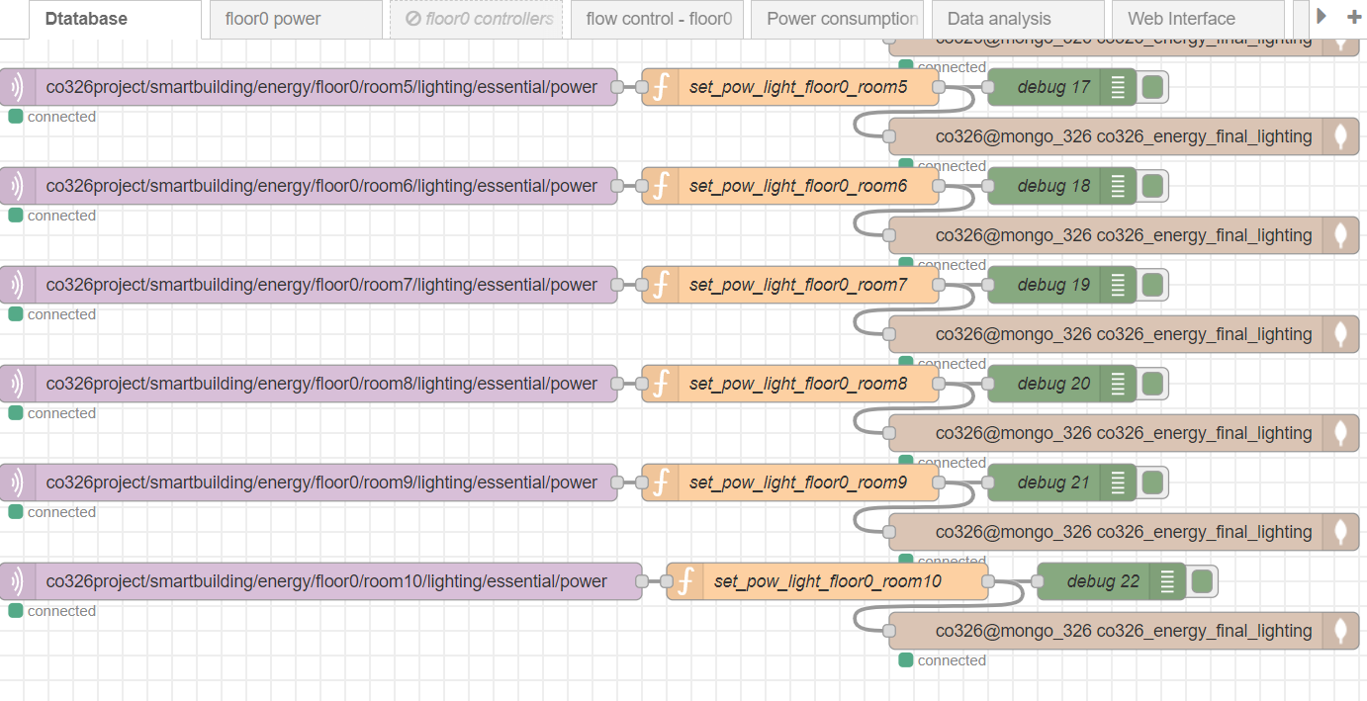
Database
MongoDB as database.
Two collections.
Co326_energy_final
Sensor_name
Floor_no
Room_no
Time
power
co326_energy_final_lighting
Sensor_name
Floor_no
Room_no
Line
Time
power

Slide 19
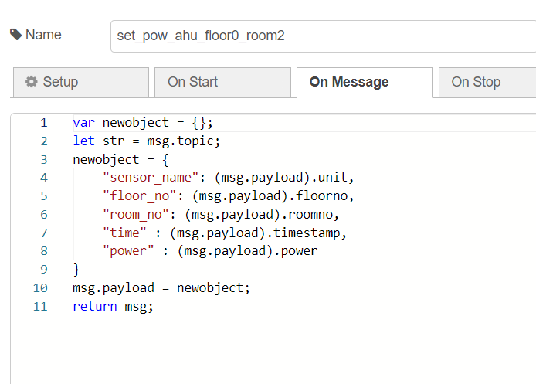

Slide 20
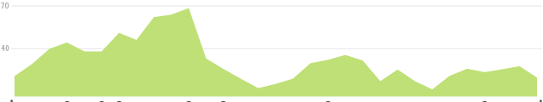
Data Analysis
threshold
Calculate threshold
Set threshold value to a global variable
Collecting data
MongoDB
if (collection.length < defined_length) {
threshold = Infinity;
}else{
threshold = mean + 1* std;
}
Is power usage > threshold
Normal mode
No
Power saving mode
Yes
Making decisions

Slide 21
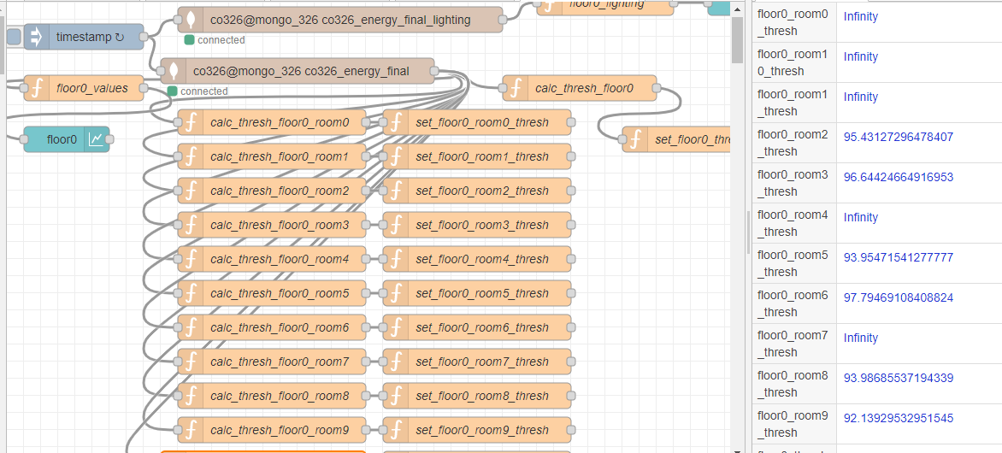
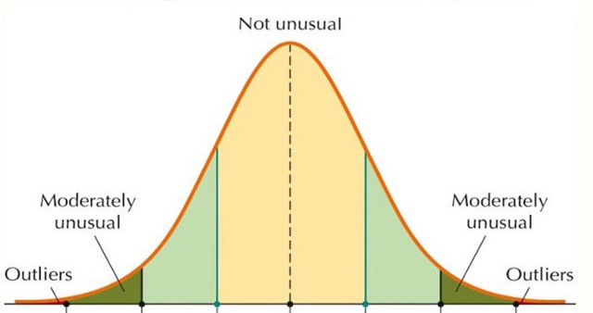


Slide 22
Process controlling and algorithms
Finish
Start
Turn on
Finish
No
If
room_power
>
Room_power_threshold
?
Turn on
Yes
Occupancy?
Turn off
Yes
No
Yes
If the device is essential?
Yes
If it is Day-time?
(For non essential lights)
Turn off
No

Slide 23
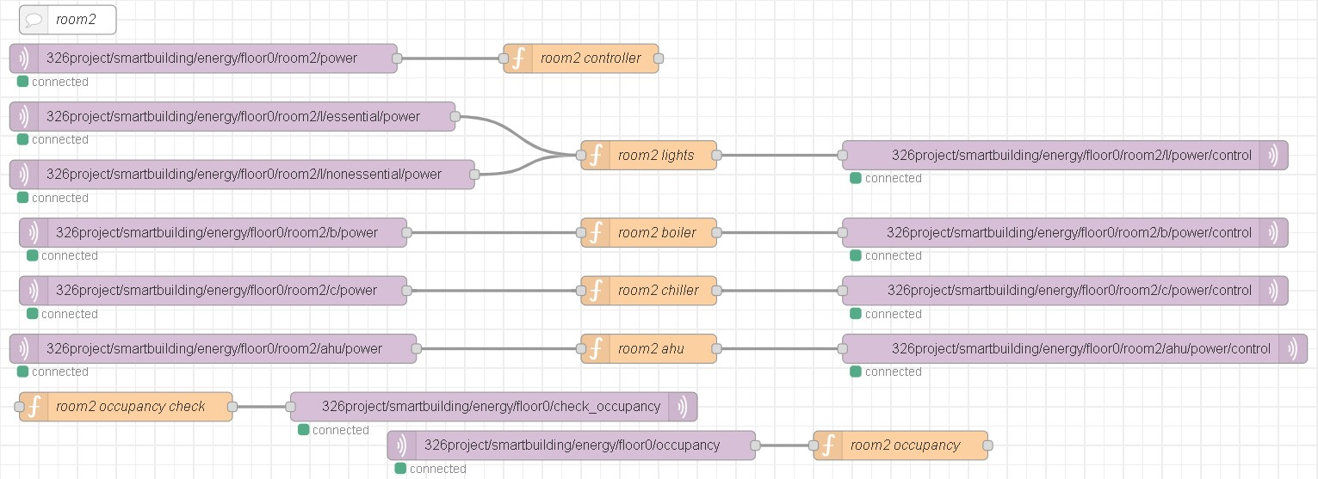
Process controlling and algorithms

Slide 24
Display the data in the database
Displayed power consumption against time in a line graph in node red dashboard.
Helps us to see the variation of the power consumption.
Can do the necessary improvements accordingly.

Slide 25
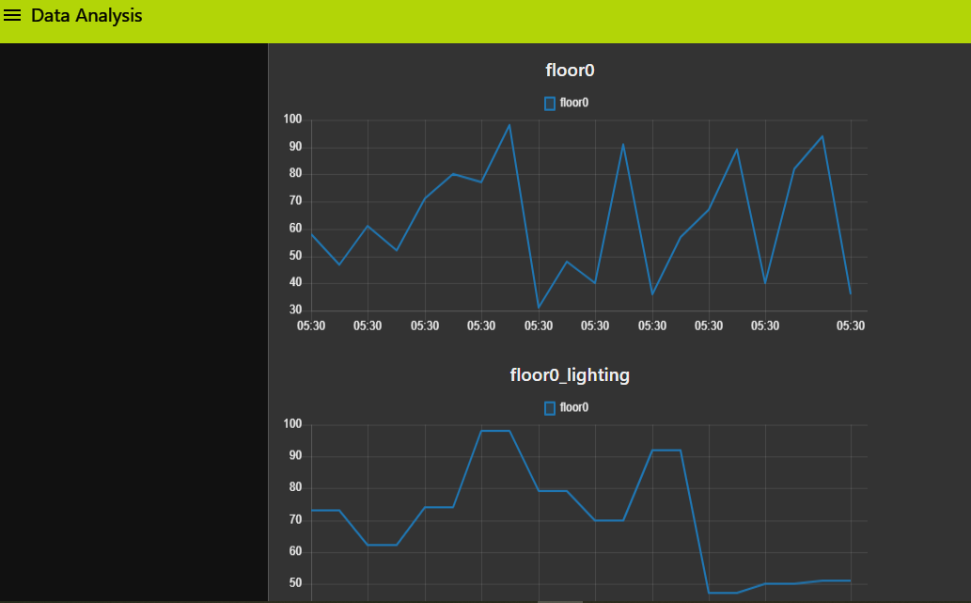
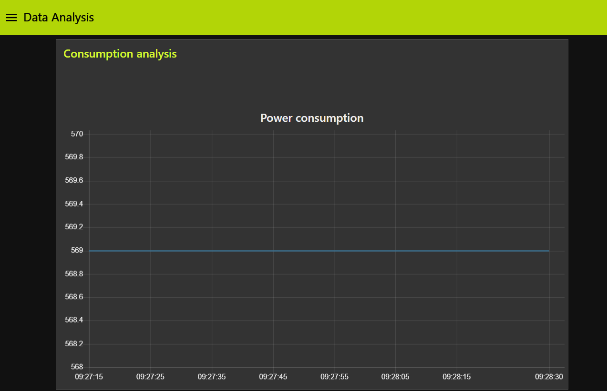
Node red dashboard - Power consumption against time

Slide 26
Demonstration

